Slide 1
Low-Functional Prototypes
Video by cottonbro from https://www.pexels.com/video/a-pen-and-a-paper-on-a-clipboard-3945495 (PD)

Slide 2
Learning Goals
Know techniques to develop prototypes with low functionality
Be able to select an appropriate prototyping technique
Low-Functional Prototypes

Slide 3
The many purposes of Prototypes
Within the design team
Communication with others
Test with potential users
Low-Functional Prototypes

Slide 4
Low-Functional Prototypes

Slide 5
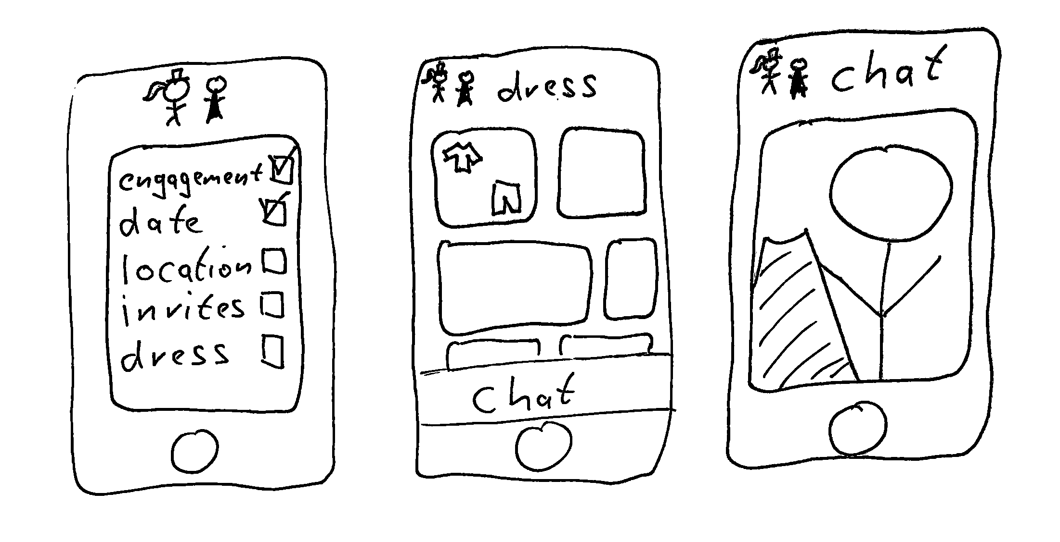
Sketches
Low-Functional Prototypes

Slide 6
Video by Judith Amores from https://vimeo.com/76766231 (CC-BY-SA)
Exploring design ideas
Communicating interface designs
Early user tests
Low-Functional Prototypes

Slide 7
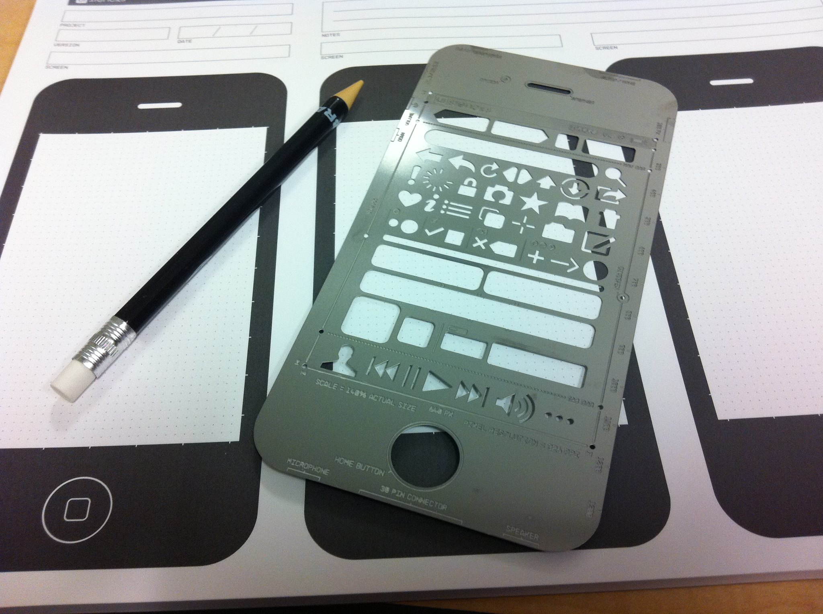
By Betsy Weber from https://www.flickr.com/photos/betsyweber/5516971798 (CC-BY 2.0)
Low-Functional Prototypes

Slide 8
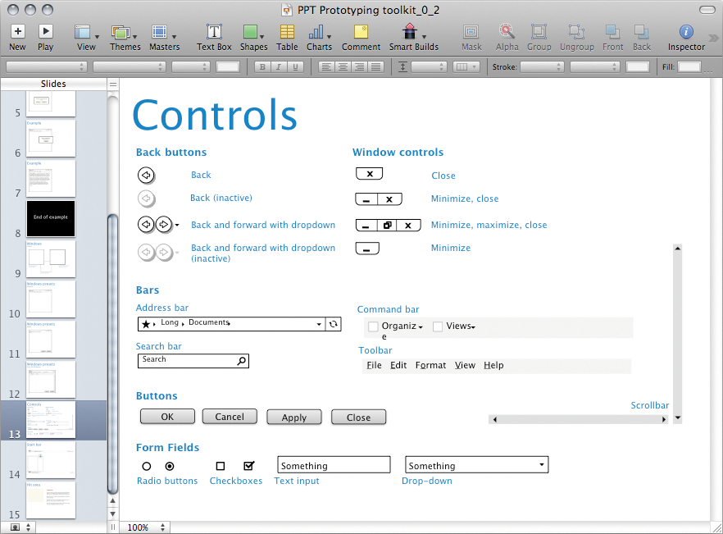
Image by Rosenfeld Media from https://www.flickr.com/photos/rosenfeldmedia/3978127831 (CC-BY 2.0)
Low-Functional Prototypes

Slide 9
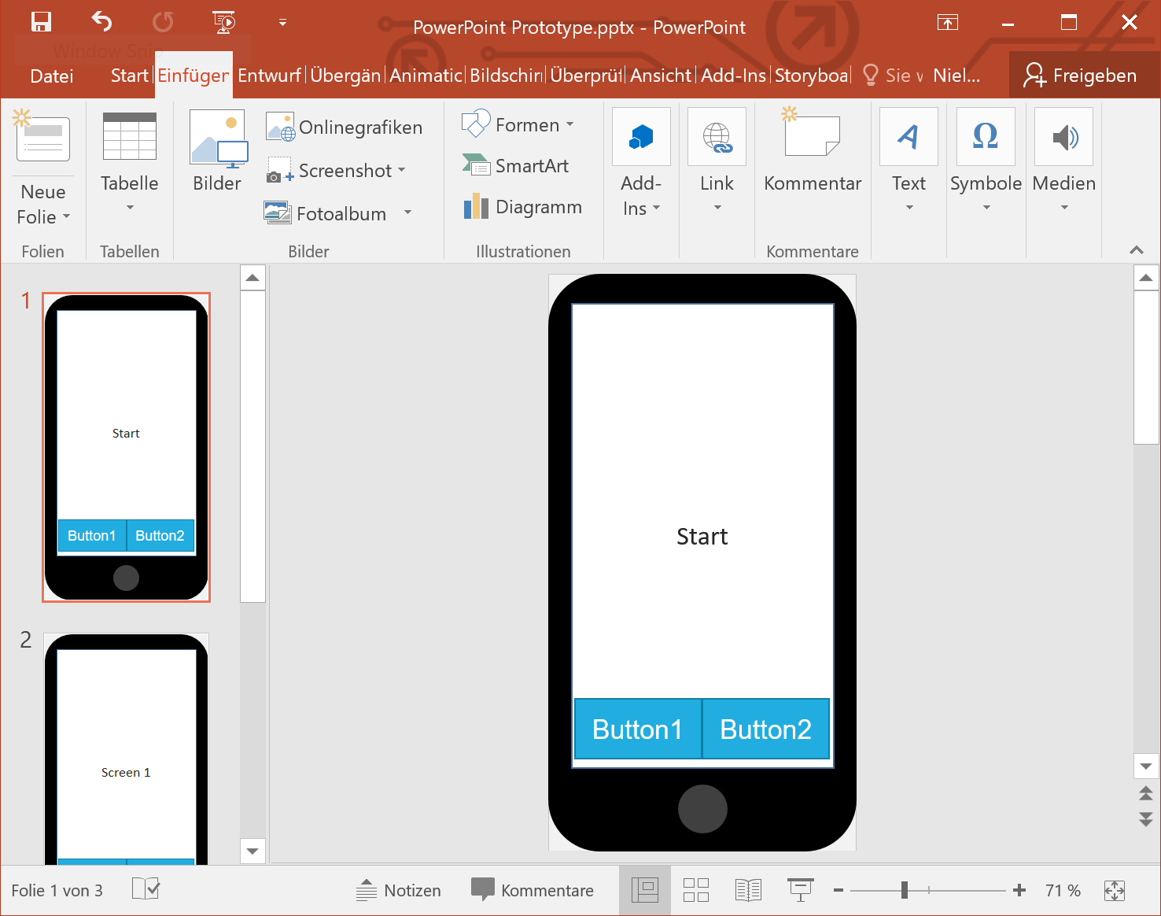
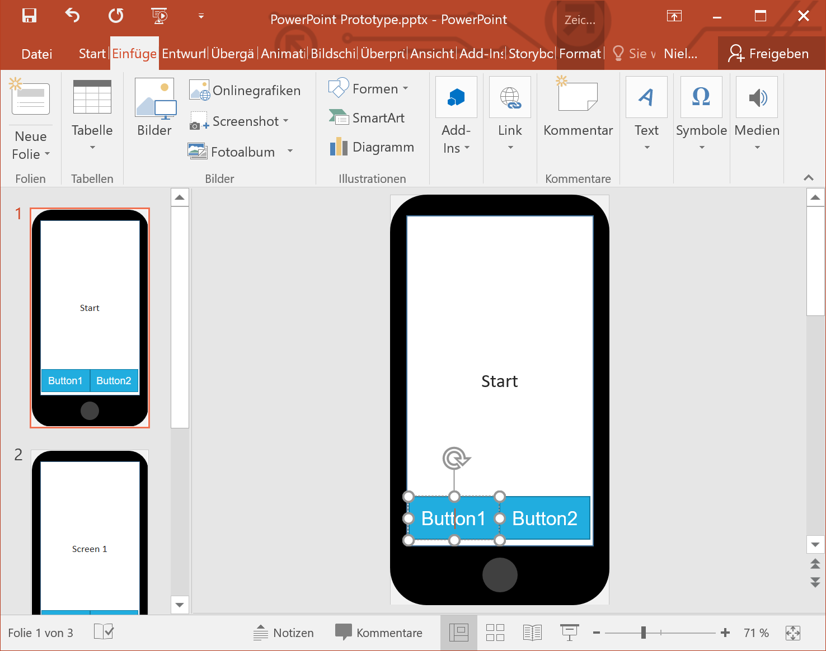
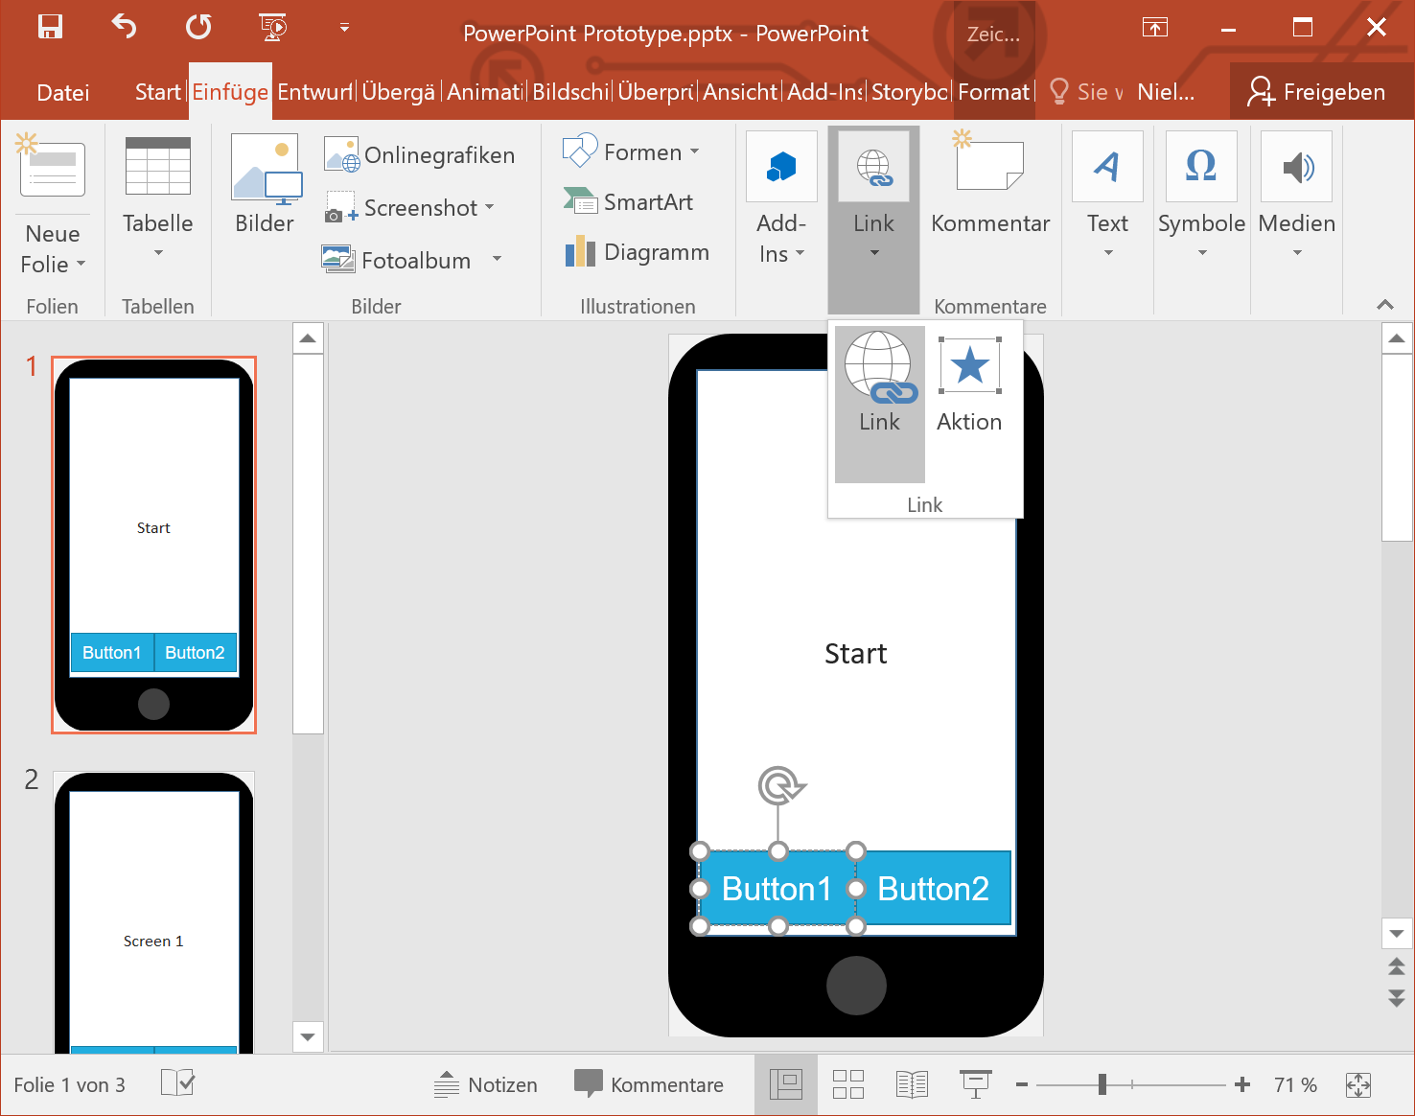
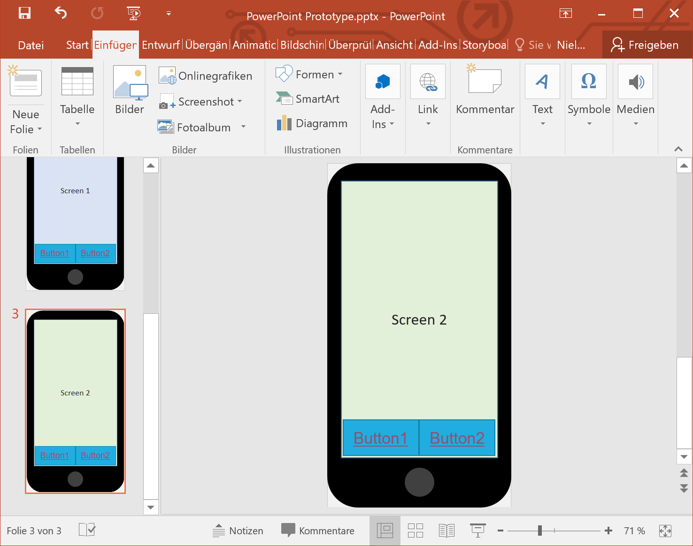
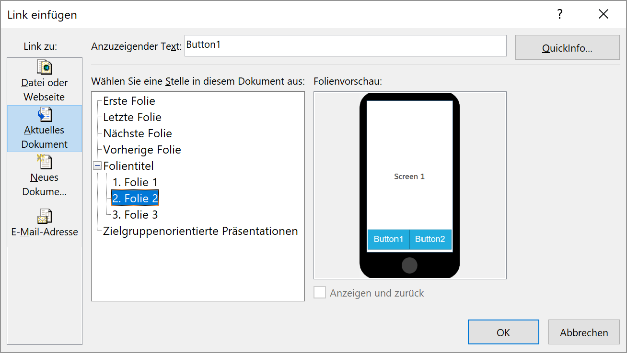
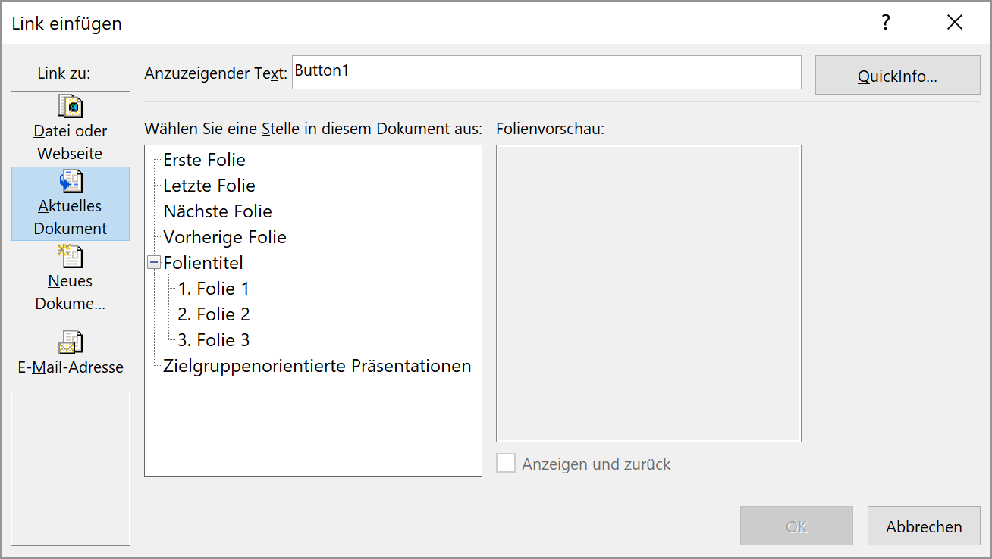
Low-Functional Prototypes

Slide 10
Low-Functional Prototypes

Slide 11
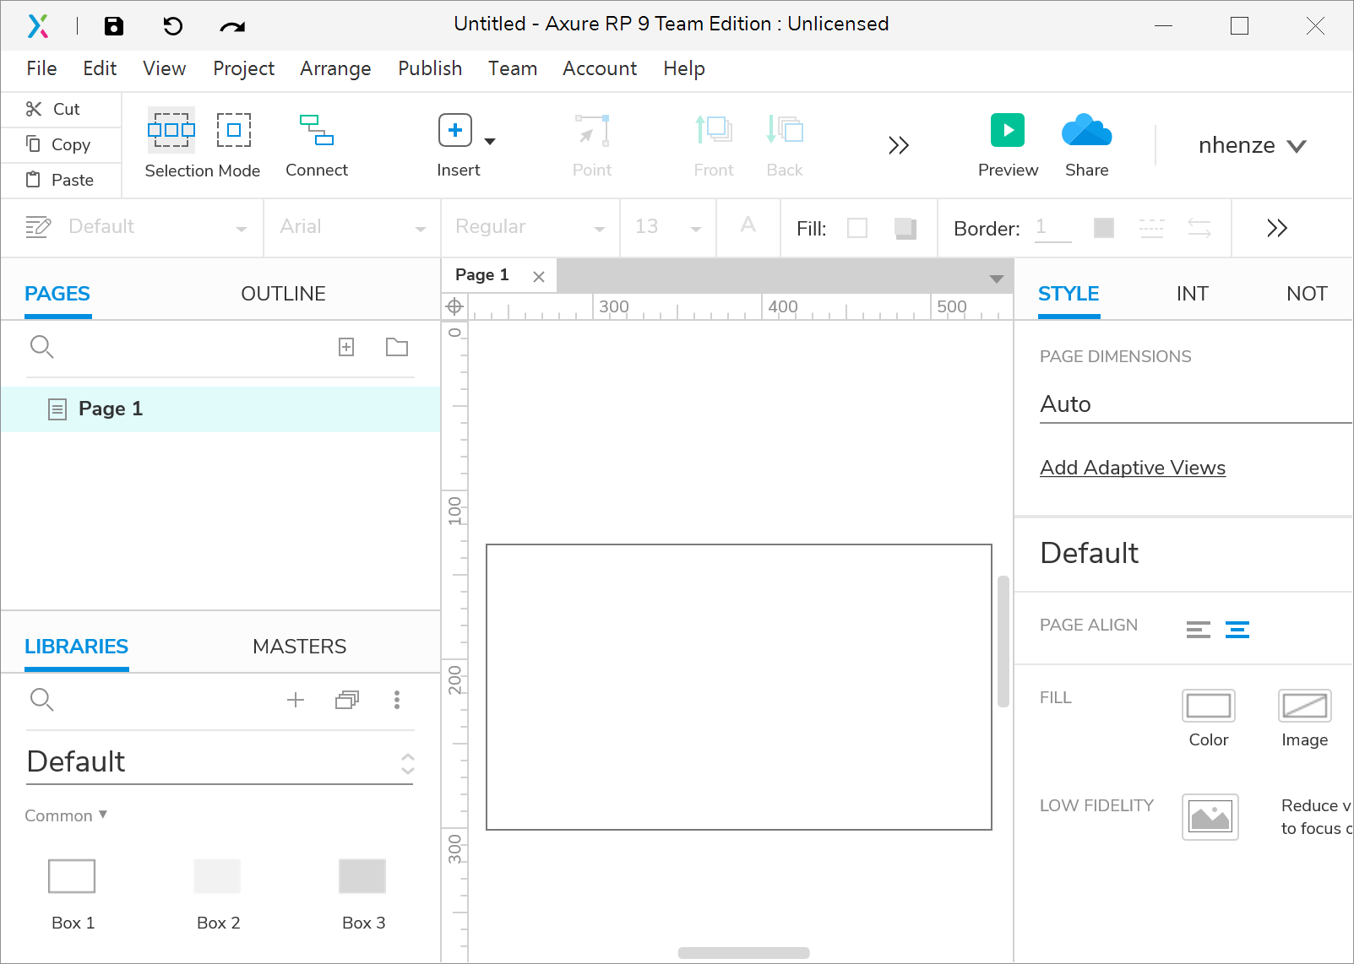
Axure RP 9
Low-Functional Prototypes

Slide 12
Advantages and Disadvantages
Low-functional prototypes
Provide little to no (automated) functions
Paper, standard software or dedicated tools to build them quickly
Advantages
Requires little effort
Speeds up the design iterations
Explore many design solutions
Disadvantages
Not everything can be realized
Efficiency is hardly measurable
Reusability is limited
Low-Functional Prototypes

Slide 13
License
This file is licensed under the Creative Commons Attribution-Share Alike 4.0 (CC BY-SA) license:
https://creativecommons.org/licenses/by-sa/4.0
Attribution: Niels Henze
For more content see: https://hci-lecture.de

